Slide 1
MINI PROJECT
By
TAMIZHAZHAGAN S
SHABHARESWAHARAN G

Slide 2

PROJECT TITLE

Slide 3
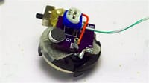
INTRODUCTION
The wireless FM bug is a sensitive miniature very high FM wireless microphone transmitter of the type “Wide Band Frequency Modulation Wireless Microphone (WBFMWM)”. Basically, it serves as a detective device to secretly monitor conversation and can be used to detect lies. It can be considered as a surveillance device.

Slide 4

How it Works ?
AM and FM radio stations work by sending out shows via radio towers. Listeners that have receivers in their car or at home can tune in. Not many people know this, but AM and FM stand for: AM = Amplitude Modulation. FM = Frequency Modulation. Both are transmitted over the air via radio waves.

Slide 5
COMPONENTS REQUIRED
Resistor R1=22kΩ 10) Inductance L1=8 Turns, 6mm DIA AIR CORE of 25 SWG
Resistor R2=47kΩ ENAMELLED COPPER WIRE
Resistor R3=330Ω 11) Tranistor (NPN) T1=2N3904/BF494
Capacitance C1=1nF 12) MIC 1
Capacitance C2=1nF 13) Antena 1
Capacitance C3=4.7pF
Capacitance C4=1nF
Capacitance C5=22nF
Variable Capacitance VC1=50pF

Slide 6
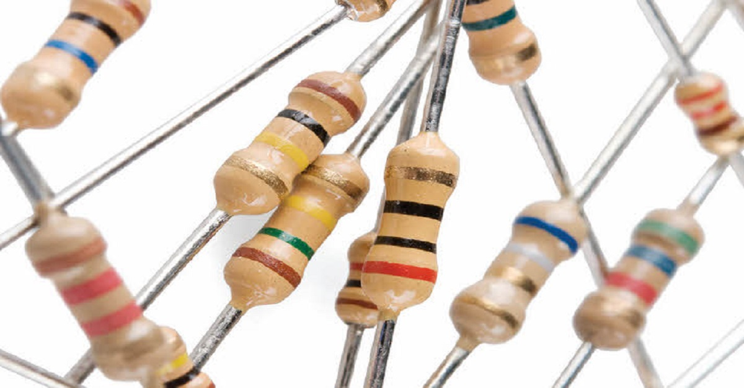
RESISTOR
A resistor is used to protect the base of the transistor from excessive current flowing from point A. Resistors are also commonly used to prevent excessive current from flowing between B and C. Fig : A resistor is typically necessary to protect the base of a transistor from excessive current.

Slide 7
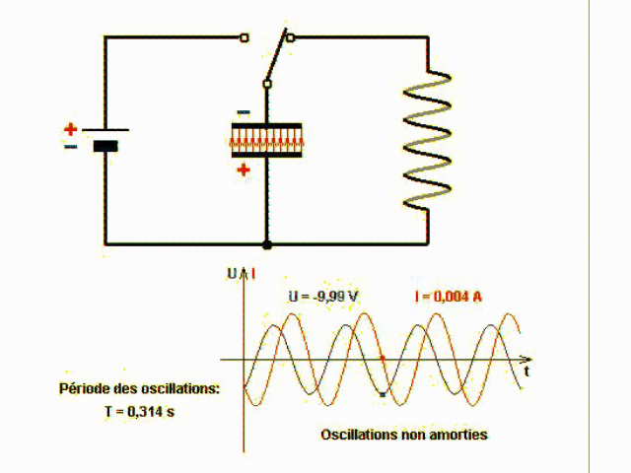
CAPACITANCE & INDUCTANCE
L and C are the main tuning components with the circuit oscillating at the resonant frequency of L/C. C and the characteristics of the transistor will also affect the oscillating frequency. The final stage is often referred to as a Colpitts oscillator.

Slide 8
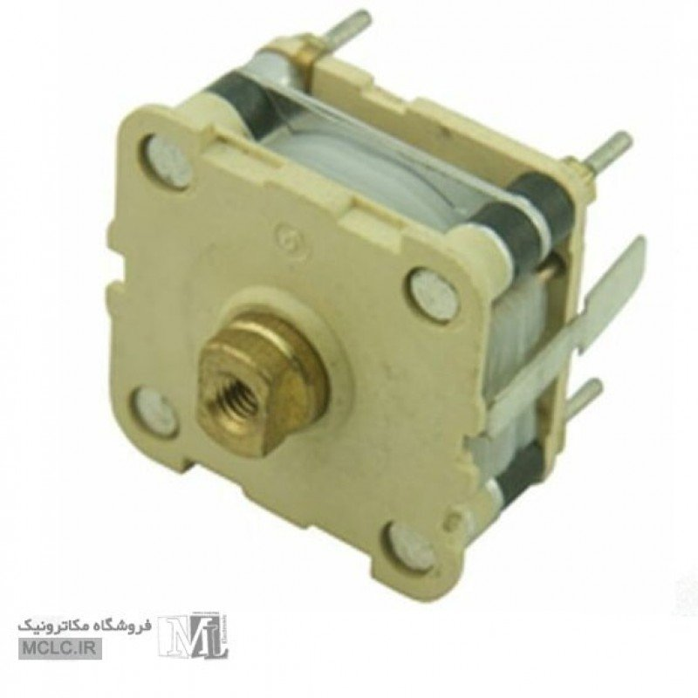
VARIABLE CAPACITOR
The variable capacitor is used to change the resonant frequency for fine modification to the FM frequency band. The modulated signal from the antenna is radiated as radio waves at the FM frequency band and the antenna is nothing but copper wire of 20cm long and 24 gauge.

Slide 9
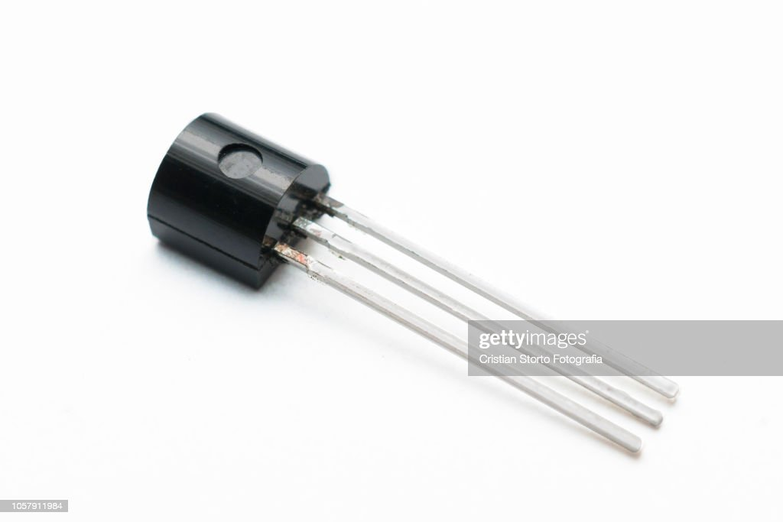
TRANSISTOR
The transistor used in this circuit is an NPN transistor used for general purpose amplification. If the current is passed at the inductor L1 and variable capacitor then the tank circuit will oscillate at the resonant carrier frequency of the FM modulation. The negative feedback will be the capacitor C2 to the oscillating tank circuit.

Slide 10
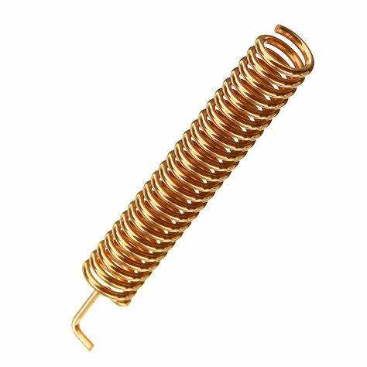
COPPER ANTENNA
Simple copper wire can be used to make antennas. Copper wire antenna technically works to improve the frequency and signal strength, whether it is electrical signals or radio waves. The simplest type of antenna that is made using a copper wire is a dipole antenna.

Slide 11
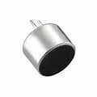
MIC (or) IN-PUT AUDIO
A microphone is an instrument that converts sound to electrical signal.
So basically it’s a transducer that converts one form of energy to another form.
Microphone takes sound wave or the variation in pressure of air as input and gives electrical signals as an output.

Slide 12
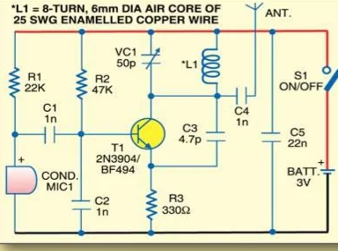
CIRCUIT DIAGRAM

Slide 13
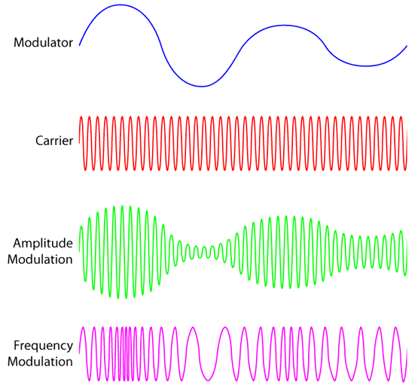
OUT-PUT WAVE FORM

Slide 14
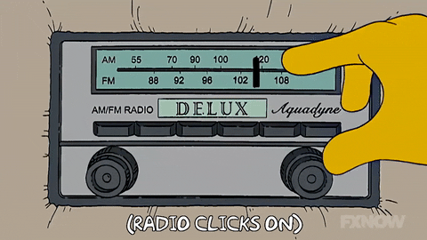
OUT-PUT VERIFY

Slide 15


